Slide 1

The Most Negative Reviewer on
Who is this jerk? And what is their problem???

Slide 2

Dissent in the Age of Algorithms
Goodreads is designed for consensus.
Most users rate books they expect to enjoy.
One-star reviews are rare—and often avoided.
Positive reviews get more likes, more visibility.
Negative reviews are buried by the algorithm.
This creates a feedback loop of praise.
Critical voices become statistical anomalies.

Slide 3
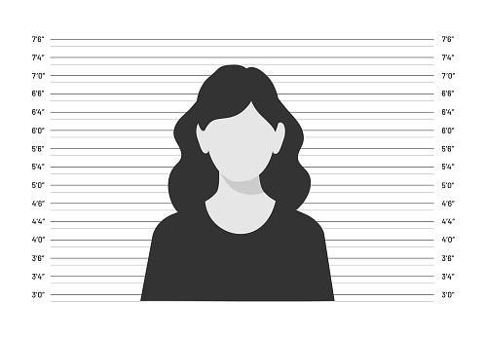
Finding Reviewer X
36 reviews, written between 2012 and 2017
Average rating: 1.39 stars
29 one-star reviews
Only one five-star review
Not random. Not trolling.
“If I received a review from this user, I think I would actually cry.”

Slide 4
Control, Coercion, and Romance
“Control is not protection.”
“Even when the narrative condemns him, it’s framed as a tragic fall—not proof that he was never safe to begin with.”
“You can’t just slap a redemption arc on coercion and call it growth.”

Slide 5


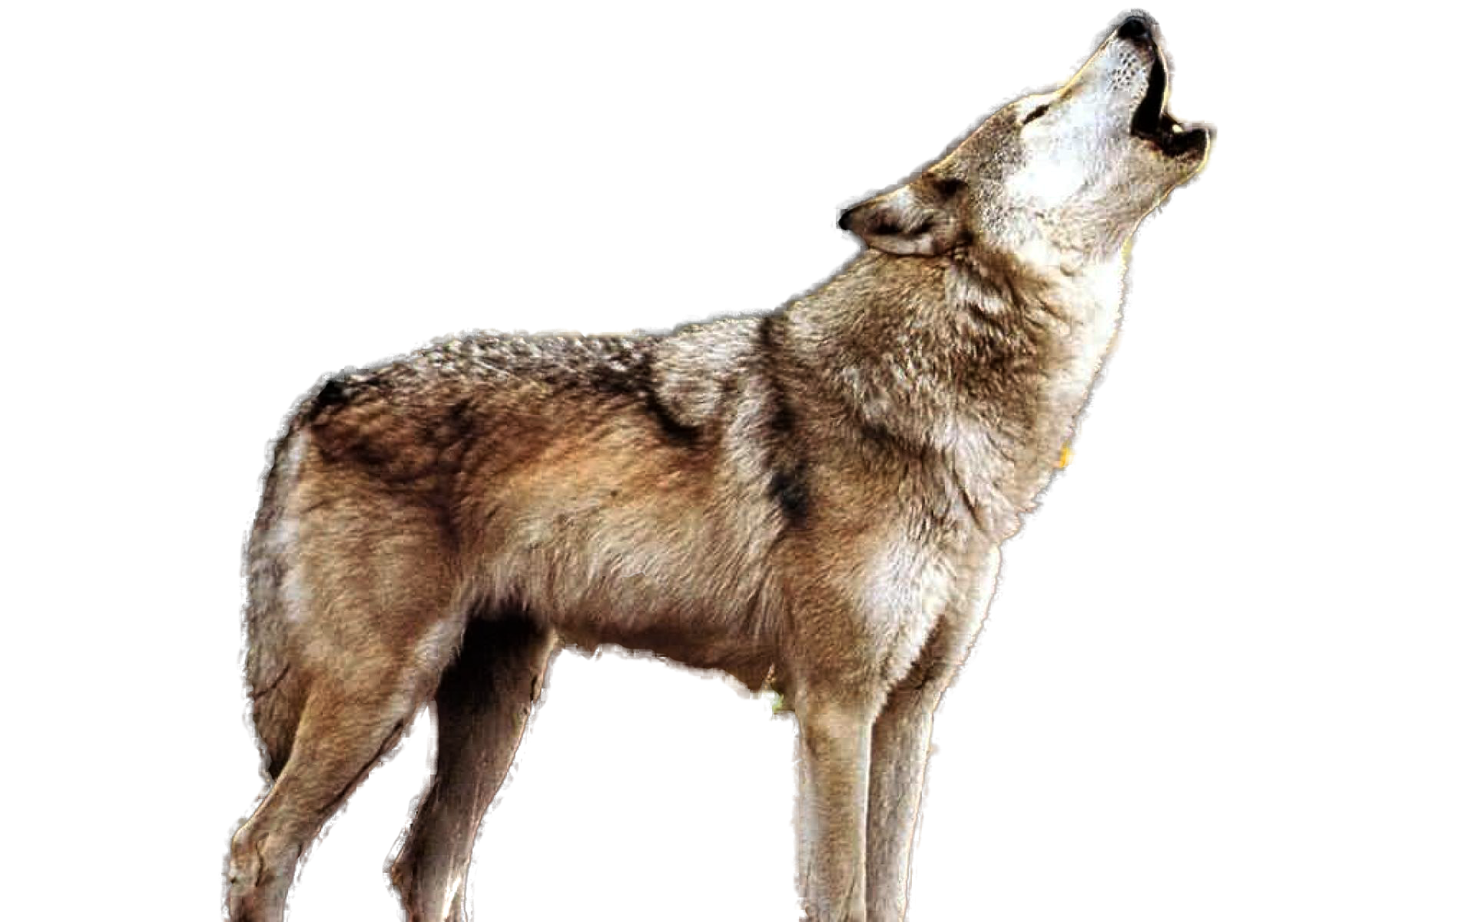
Accuracy and Narrative Contract
Notes:
“GENETICS DO NOT WORK THAT WAY. Go read a Biology 101 book. No love, a molecular biologist.”
“Swords were NEVER carried on the back during combat. It’s not just wrong—it’s lazy.”
“The alpha wolf is a myth. Wolves function like families.”

Slide 6
Identity and Literary Interpretation
On race and tokenism (Lady Midnight):
“Christina is not a character. She’s just a prop.” “She exists only to be inhumanly wise and give advice. This isn’t representation—it’s tokenism.”
On bisexual representation (Empire of Storms):
“Believe it or not, not all women need to end up dating a man. And we bisexuals aren’t similar to ‘whores’ nor do we do ‘anything that moves.’”
On platformed stereotypes (Throne of Glass):
“This isn’t the first time a marginalized character has been sacrificed for a white protagonist’s growth.”
On editorial critique of queerbaiting (The Bane Chronicles):
“Magnus’s relationships with women are consistently undermined or played for jokes. This isn’t meaningful bisexual representation.”

Slide 7
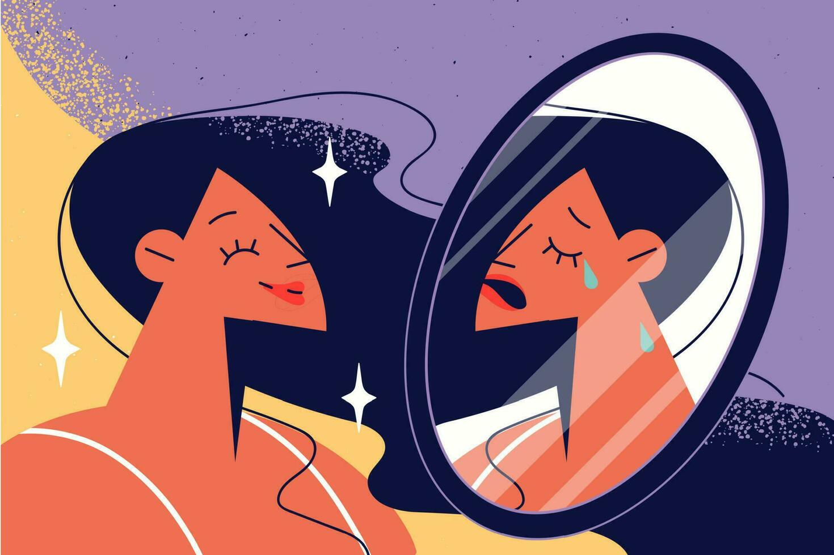
The Exception That Proves the Rule
“Keladry is my favourite character from Tamora's world … Her quiet, almost cold demeanour is something I greatly identify with.”

Slide 8
The Critic and the Algorithm
If someone read your work the way she reads...
What would they see? What would they say? And would you be ready to hear it?

